Slide 1
Electronic Banking (IT) RCSA Summary Report
March 2022
Business Head – Debi Gupta, EVP, CTO
Department Leads/ Team - Anthony Scarola, Allen Lum, Rajesh Kalyanaraman,
Jose Mendez, Marie Siegel, Joseph Armenti, Stephen Apruzzese, Franklin Cabral,
Joe Petti, Robert Celona, Nicholas Creer, Robert Martin

Slide 2
Electronic Banking (IT) RCSA Highlights
Information Technology supports the Bank’s Electronic Banking IT controls with nine (9) IT key process areas that are summarized in the table below. Overall, the inherent risk is rated “high”, and the controls “strong”, which result in an overall residual risk of “low”.
Risk Area | Inherent Risk | Control Rating | Residual Risk
I. Authentication Controls | High | Strong (*) | Low
II. Privilege Access and Segregation of duties | Very High | Strong | Moderate
III. Transaction Dollar Limits (Staff) | Very High | Strong | Moderate
IV. Transaction Dollar Limits (Customers) | Very High | Strong | Low
V. Changes to Customer Administrative Data | High | Strong | Low
VI. IT Electronic Banking Policies | High | Strong | Low
VII. Periodic Review of Users Entitlements | High | Strong | Low
VIII. Monitoring | Very High | Adequate | High
IX. Process, Store and Transmit Data | High | Strong | Low
(*) There are four authentication controls. Three of which are rated “strong”, and one is rated “weak”.

Slide 3
Electronic Banking (IT) RCSA Summary
Overall, the Electronic Banking Technology Risk and Control Self-Assessment (RCSA) process identified nine inherent risks, across nine key processes. There is a total of twenty-one controls, consisting of sixteen key controls and five non-key controls. Only the sixteen documented key controls are tested by IT RCSA in 2021. In conclusion, the majority of the residual risks are rated “low”, with one identified issue. The action plans for this identified issue is registered into MetricStream for remediation.
The Electronic Banking (IT) RCSA was conducted using the Apple Bank risk management process and approach. The IT RCSA process assesses the risks, the control design, and the operating effectiveness of key electronic banking technology controls. The results were finalized in March 2022 for the fiscal year 2021, with one identified issue. This is an existing issue, which has been reported during the Gramm-Leach-Bliley Act (GLBA) review .
The above identified issue relates to the lack of Multifactor Authentication (MFA), in order to authenticate the electronic banking customers. This issue affects two applications: Ensenta and Centrix, which do not support MFA. Management has developed an action plan for the remediation of the identified Issue.
Ongoing tracking and monitoring of the open issue is performed via MetricStream GRC software.
* Identified in the 2020 IT RCSA

Slide 4
Electronic Banking (IT) RCSA Strengths and Weaknesses
Electronic Banking (IT) (Low)
Strengths:
To ensure secure and operational success in Electronic Banking, the following IT controls have been implemented:
User access controls for electronic banking features;
Security monitoring over customer activity;
Electronic banking (IT) policies and procedures to provide governance;
Periodic entitlement reviews for user access; and
Monitoring of the electronic banking platform and funds transfer activities.
Weaknesses:
Multi Factor Authentication has not been implemented for two applications:
Centrix; and
Ensenta

Slide 5
2021 Electronic Banking (IT) RCSA
RCSA Year | Inherent Risk | Control Rating | Residual Risk | Risk Trend
2021 | High | Strong | Low | Stable
2020 | N/A | N/A | N/A | N/A
Business Description
Apple Bank’s IT Senior Management is responsible for the implementation and management of the Electronic Banking and all associated processes. This includes the design and implementation of controls and supporting IT policies and procedures, including: Change Management, Business Continuity, Asset Management, Service Desk and Problem Resolution, and System Development Life Cycle.
Business Head
Debi Gupta
Business Leads
All Debi Gupta’s Direct-Reports
Business Outlook
The risk trend for this Electronic Banking (IT) is stable for 2021
Inherent Risk
Overall inherent risk rating: High
Inherent Risk Rating breakdown (for key controls only)
(3 – Very High, 6 – High)
Controls
Only key controls were tested
The average of the key controls are rated Strong. (14 - Strong, 1 - Adequate, 1 - Weak).
Residual Risk
The average of residual risks for key controls are rated Moderate (1 – High, 2 - Moderate, 6 - Low)

Slide 6
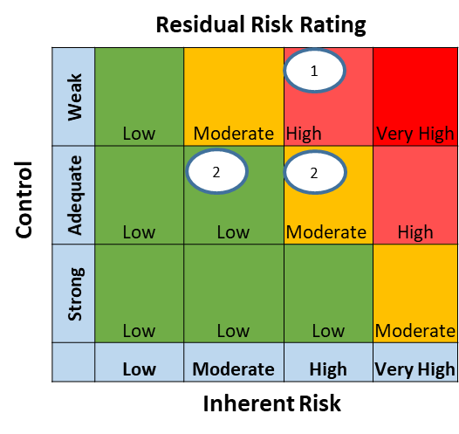
2021 Electronic Banking (IT) RCSA
Residual Risk Themes
High Residual Risk themes include:
Multi Factor Authentication – two application do not have MFA
Monitoring of platform and transfer activities – this is performed by Q2, who alerts the security team of any events and alerts
Moderate Residual Risk themes include:
Application Administrator Rights – risk of inadequate segregation of duties
Large Dollar Customer Transaction – risk of inadequate approval and review of large dollar amounts transaction (customers)
Monitoring of Customers Activity (Non-Key) – risk of inadequate review and monitoring of customer activity for fraud
Low Residual Risk themes include:
Authentication Controls - risk of ineffective use of password and multi-factor authentication controls
Large Dollar Transaction (staff) – risk of inadequate approval and review of large dollar amounts transaction (staff)
Changes in customer administrative data – risk of adequate control over the updates for customer geographical changes
IT Electronic Banking Policies – risk of untimely update and review of policies and procedures.
Periodic Review of User Entitlements – risk of untimely or inadequate review of user entitlements
Findings/Issues Description
Summary of Action Plans
Multi Factor Authentication has not been enabled for two Electronic Banking applications.
Pending
Key Statistics
9 Key Risks Identified
21 Mitigating Controls (16 Key and 5 non-Key)
16 Key Controls Tested (5 non-Key controls are not tested)
1 Key Residual Risks – High
2 Key Residual Risks – Moderate
6 Key Residual Risks – Low

Slide 7
Electronic Banking (IT) - Key Residual Risks
Key Process | Inherent Risk Rating | Residual Key Risk | Control Rating | Control Summary | Issue/Finding | Action / Recommendation | Due Date
Authenticating Controls | High | Multi Factor Authentication has not been implemented for two applications: Centrix; and Ensenta. | Weak | Customers have controls in place to authenticate via multifactor authentication, which requires the user to provide two or more verification factors to gain access to a resource such as an application, or an online account | TBD | TBD | TBD

